Slide 1

National Income and Related Aggregates
Principles of Macro Economics 1
ECONA 201

Slide 2

Definition of National Income
National income refers to the aggregate income earned by the normal residents of a nation during a given period of time.
In the words of Brooman, “National product is the sum total of final goods and services produced by labour and wealth of a nation during a period of one year”.

Slide 3
Domestic Territory Of a Country
In economics, it refers to economic territory which refers to the geographical territory administered by a government within which persons, goods and capital circulate freely. Domestic territory of a nation includes the following:
Territory lying within the political frontier including territorial waters of a country.
Ships and air crafts operated by residents of the country across different parts of the world.
Embassies, consulates and military establishments of a country located in abroad.

Slide 4
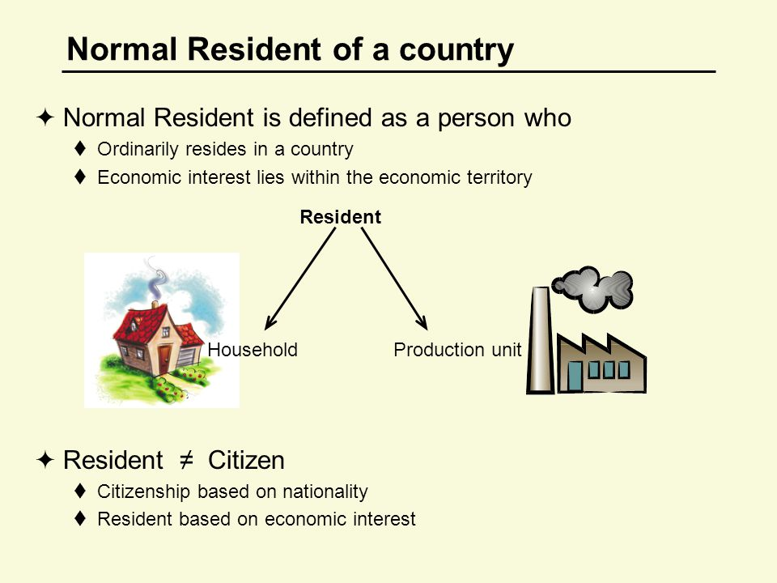

Slide 5

Depreciation or Consumption of Fixed Capital
Depreciation is also called consumption of fixed capital.
Depreciation means loss of fixed assets overtime due to wear and tear. Loss of fixed assets happen on account of normal wear and tear, normal rate of accidental damages and expected obsolescence.
Gross Product Versus Net Product :
Net product or Income = Gross Product or Income – Depreciation
Gross Product or Income = Net Product or Income + Depreciation

Slide 6

Market price versus Factor cost
Primary difference between the two is net indirect tax. The factor cost includes the payments to the factors of production. While the market price includes the payments to the factors of production as well as net indirect taxes. Now let’s understand what is indirect taxes.
1) Indirect taxes: The taxes which are imposed by the government on the production, sale or import of goods. Excise duty, sales tax and customs duty are the three important examples of indirect taxes. Indirect taxes tend to increase the market price of the goods and services.

Slide 7
2) Subsidies: Subsidies are monetary help from the government to the producers with a view to encourage the production of certain commodities. Subsidies are deducted from the indirect taxes to find out net indirect taxes.
Important Formulas:
Net Indirect Taxes = Indirect Taxes – Subsidies
Factor Cost = Market Price – Indirect Taxes + Subsidies
Market Price = Factor Cost + Net Indirect Taxes

Slide 8
Net Factor Income From Abroad: It is the difference between the factor income earned from abroad by the normal residents of a country and income paid for the factor services rendered by non residents within the domestic territory of the country.
Net Factor Income from Abroad = Factor income from abroad by the normal residents – factor income of non residents in the domestic territory

Slide 9
Gross Domestic Product at Market Price = Market Price x Final goods and services produced in a given year
Gross National Product = Gross Domestic Product + Net Factor Income from Abroad
Net National Product at Market Price = Gross Domestic Product at Market Price – Depreciation +Net Factor Income from Abroad
Net Domestic Product at Market Price = Gross Domestic Product at Market Price – Depreciation
Net Domestic Product at Factor Cost = Net Domestic Product at Market Price – Indirect Taxes + Subsidies
Gross Domestic Product at Factor Cost = Gross Domestic Product at Market Price – Indirect Taxes + Subsidies
National Income or Net National Product at Factor Cost = Net Domestic Product at Factor Cost + Net Factor Income from Abroad
Net National Product at Factor Cost = Net National Product at Market Price– Net Indirect Taxes( Indirect Taxes – Subsidies)
Net National Product at Market Price = Net National Product at Factor Cost +Net Indirect Taxes( Indirect Taxes – Subsidies)

Slide 10


